Slide 1


To our class

Slide 2
Brainstorm
Activities at the camp

Slide 3
Unit 3- MY FRIENDS
Period 20:
Lesson 5- Skills 1

Slide 4

Reading
1. Read the advertisement for the Superb Summer Camp and choose the best answer.
The camp is for kids aged between _____
a. 6 – 9 b. 10 – 15 c. 18 - 19
2. The camp is in the _____
a. sea b. city park c. mountains
3. The camp lasts for _____ days.
a. three b. four c. five

Slide 5
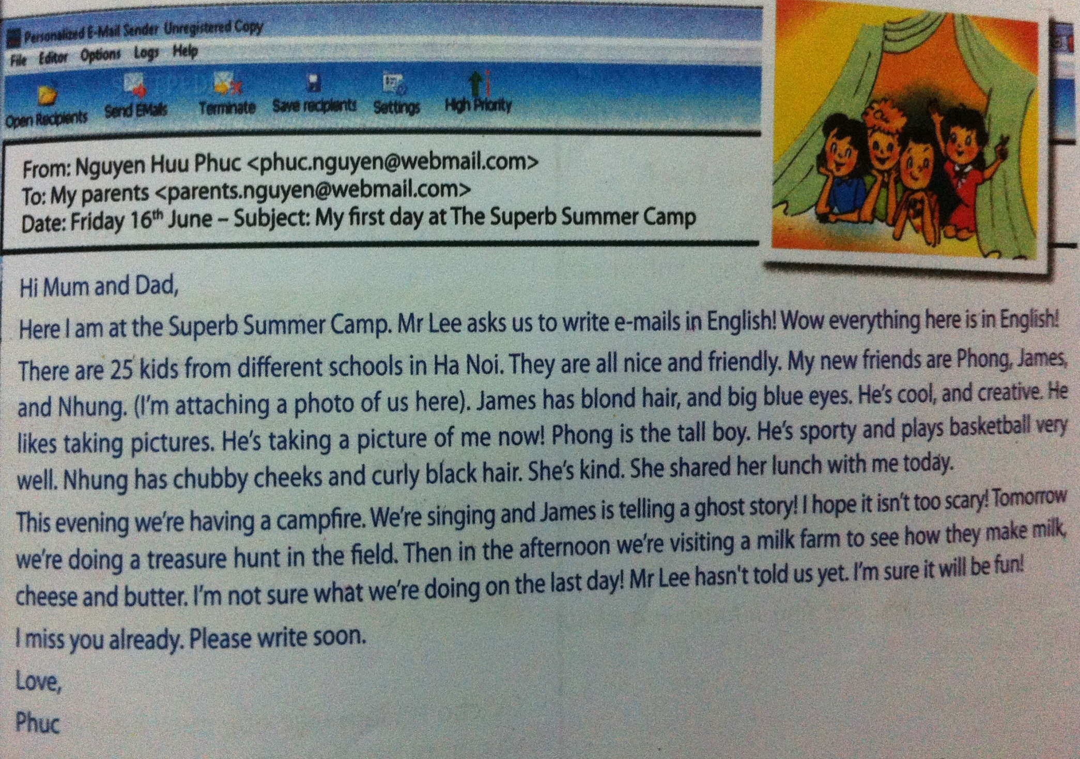

2. Read the text quickly and answer the questions.
Is the text a letter, an email, or a blog?
What is the text about?
Is Phuc enjoy himself?
It’s an email.
It’s about a stay at the Superb Summer Camp.
Yes, he is.

Slide 6
3. Read the text again and write T or F.
Phuc is writing to his teacher. ________
Phuc has four new friends. ________
Phuc thinks Nhung is kind. ________
Phuc likes scary stories. ________
In the evening, the kids are playing inside. ________
They are working on the milk farm tomorrow. ________
The children can speak Vietnamese at the camp. ________
his parents
F
three
F
T
He hopes it isn’t too scary.
F
F
having campfire and telling stories
F
visiting a milk farm
F
speak English only

Slide 7
Speaking
4. Make your own English camp schedule.
 | Morning | Afternoon
Day One
Day Two
Day Three

Slide 8
Homework
- Write an e-mail to your parents to tell them about your camping.

